Slide 1
Wireless Security
Information Security

Slide 2
Wireless Security
Wireless Security
  Wireless Network
  Wireless Attacks: Bluetooth
  IEEE 802.11 Wireless Standard
  Wireless Network Modes
  Wireless Security Overview
  Wireless Networking Components
  Wireless LAN Attacks
  Six Modes of Wireless NICs
  Securing Wireless Networks

Slide 3
Wireless Security
Wireless LAN Attacks
Wireless networks have been vulnerable targets for attackers
  Not restricted to a cable
Types of wireless LAN attacks
  Discovering the network
  Attacks through the RF spectrum
  Attacks involving access points
Notes:
https://www.mathsisfun.com/physics/waves-radio-microwave.html

Slide 4
Wireless Security
Wireless LAN Attacks
Discovering the network
  One of first steps in attack is to discover presence of a network
Beaconing
  AP sends signal at regular intervals to announce its presence and provide connection information
  Wireless device scans for beacon frames
WLAN Probe
  The WLAN clients or stations use probe request frame to scan the area for availability of WLAN network.
War driving
  Act of searching for Wi-Fi networks from a moving vehicle.
Notes:
bee·kn
Beaconing: In a Wi-Fi network, the continuous transmission of small packets (beacons) that advertise the presence of the base station
Wardriving is the act of searching for Wi-Fi networks from a moving vehicle.
When wardriving, people may search for WiFi networks by driving around in a moving vehicle, often using a GPS device to record the location of any wireless networks they find. They then upload this data to specific websites that process the information to create digital maps of the networks in the neighborhood.

Slide 5
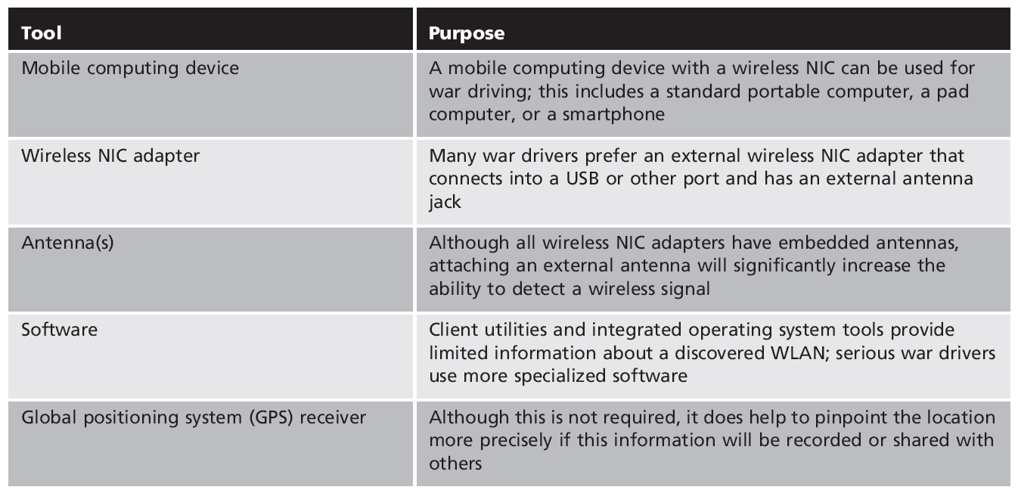
Wireless Security
Wireless LAN Attacks

Slide 6
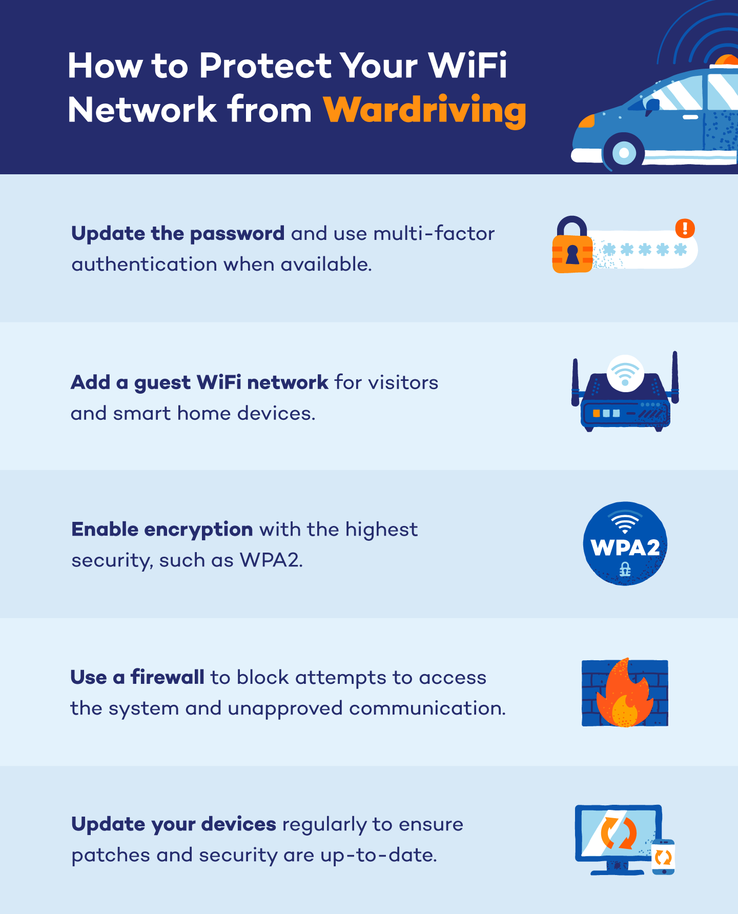
Wireless Security
Wireless LAN Attacks

Slide 7
Wireless Security
Wireless LAN Attacks
Attacks through the RF spectrum
  Wireless protocol analyzer
  Generating interference
Wireless protocol analyzer
  Wireless traffic captured to decode and analyze packet contents
  Network interface card (NIC) adapter must be in correct mode
    E.g; Promiscuous mode
Notes:
pruh·mi·skyoo·uhs: In networking terms, a computer having its network interface card set to “promiscuous mode” receives all packets on the same network segment. In “normal mode,” a network card accepts only packets addressed to its MAC Address.
pruh·mi·skyoo·uhs
In an Ethernet local area network ( LAN), promiscuous mode is a mode of operation in which every data packet transmitted can be received and read by a network adapter

Slide 8
Wireless Security
Wireless LAN Attacks
Attacks using access points
  Rogue access points
  Evil twins
Rogue access point
  Unauthorized access point that allows attacker to bypass network security configurations
  May be set up behind a firewall, opening the network to attacks
Notes:
Rowg
A rogue access point is an access point installed on a network without the network owner's permission.

Slide 9
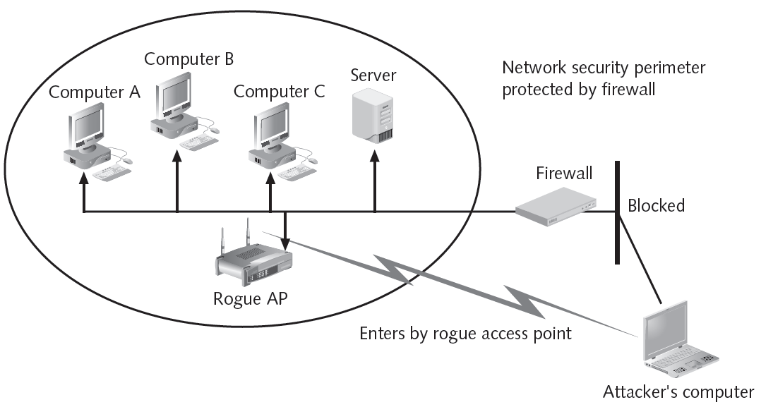
Wireless Security
Wireless LAN Attacks

Slide 10
Wireless Security
Wireless LAN Attacks
Evil twin
  AP set up by an attacker
  Attempts to copy or replica of an authorized AP
  Attackers capture transmissions from users to evil twin AP
Notes:
An evil twin attack is a hack attack in which a hacker sets up a fake Wi-Fi network that looks like a legitimate access point to steal victims' sensitive information.

Slide 11
Wireless Security
Wireless LAN Attacks
Six modes of wireless NICs
  Master (acting as an AP)
  Managed (client)
  Repeater
  Mesh
  Ad-hoc
  Monitor
Interference
  Signals from other devices can disrupt wireless transmissions
Notes:
Monitor mode, or RFMON (Radio Frequency MONitor) mode, allows a computer with a wireless network interface controller (WNIC) to monitor all traffic received on a wireless channel

Slide 12
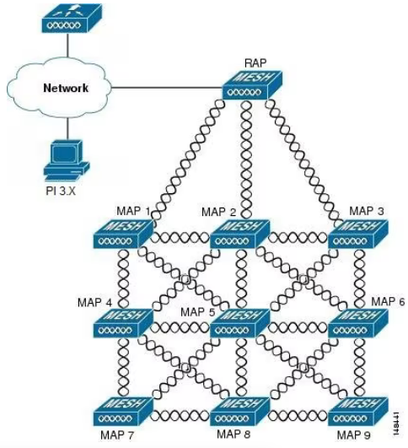
Wireless Security
Notes:
Monitor mode, or RFMON (Radio Frequency MONitor) mode, allows a computer with a wireless network interface controller (WNIC) to monitor all traffic received on a wireless channel

Slide 13
Wireless Security
Wireless LAN Attacks
Devices that can cause interference with a WLAN
  Microwave ovens
  Concrete Walls
  Theft protection devices
  Bluetooth devices
  Separate Wireless Networks in Your Own Home

Slide 14
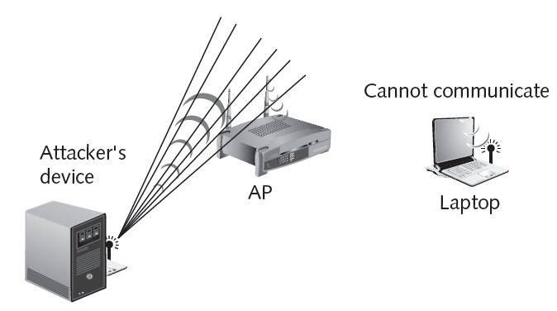
Wireless Security
Wireless LAN Attacks

Slide 15
Wireless Security
Securing Wireless Networks
Use encryption
Apply MAC-filtering
Use and enable anti-virus, anti-spyware, firewall
Turn off SSID broadcasting
Change default identifier on router
Change router’s present password

Slide 16
Wireless Security
Securing Wireless Networks: MAC Address Filtering
Method of controlling WLAN access
  Limit a device’s access to AP
Media Access Control (MAC) address filtering
  Used by nearly all wireless AP vendors
  Permits or blocks device based on MAC address

Slide 17
Wireless Security
Securing Wireless Networks: MAC Address Filtering
Vulnerabilities of MAC address filtering
  Addresses exchanged in unencrypted format
  Attacker can see address of approved device and substitute it on his own device
  Managing large number of addresses is challenging

Slide 18
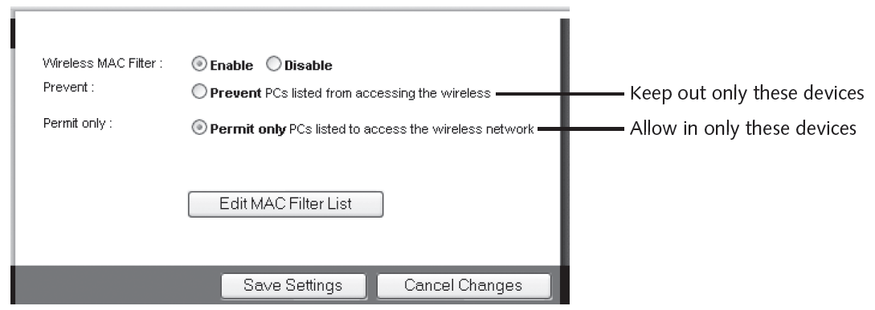
Wireless Security
Securing Wireless Networks: MAC Address Filtering

